Slide 1
Customer Discovery 4
Jaden Del Rosario
Lydia Holleman
Lola Wood

Slide 2
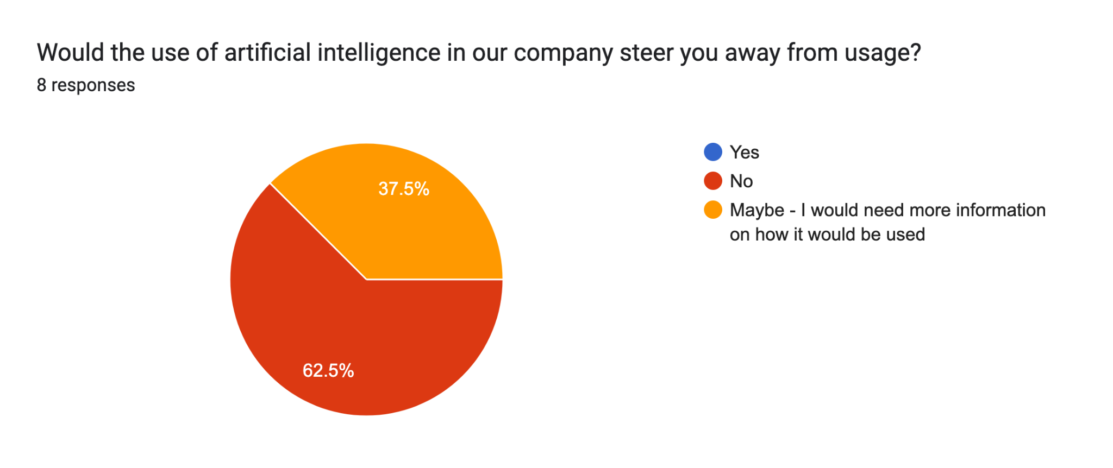
Maybe:
I just don’t like how AI is being pushed so heavily in our current state. It’s taking away creativity and individuality.
I would just want to know why it is necessary/helpful for the company
if somebody can hack it on the backend and get access to confidential data and proprietary data, it could cause problems. AI needs to be secure in every way possible for it to work.

Slide 3
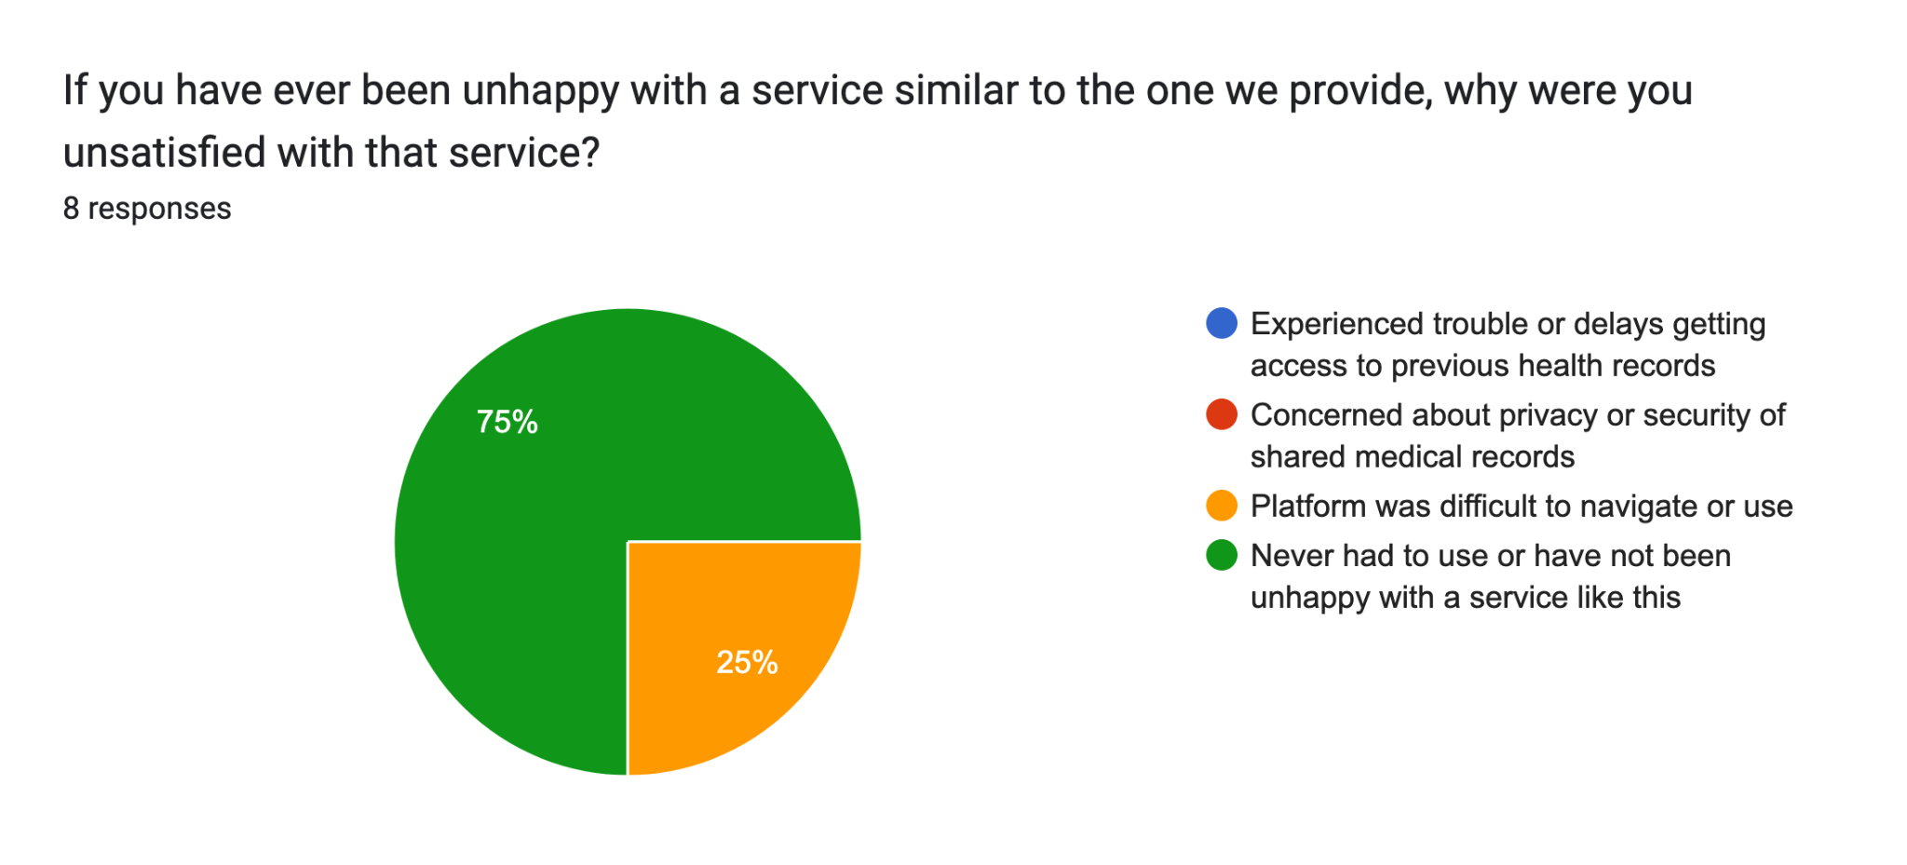

Slide 4
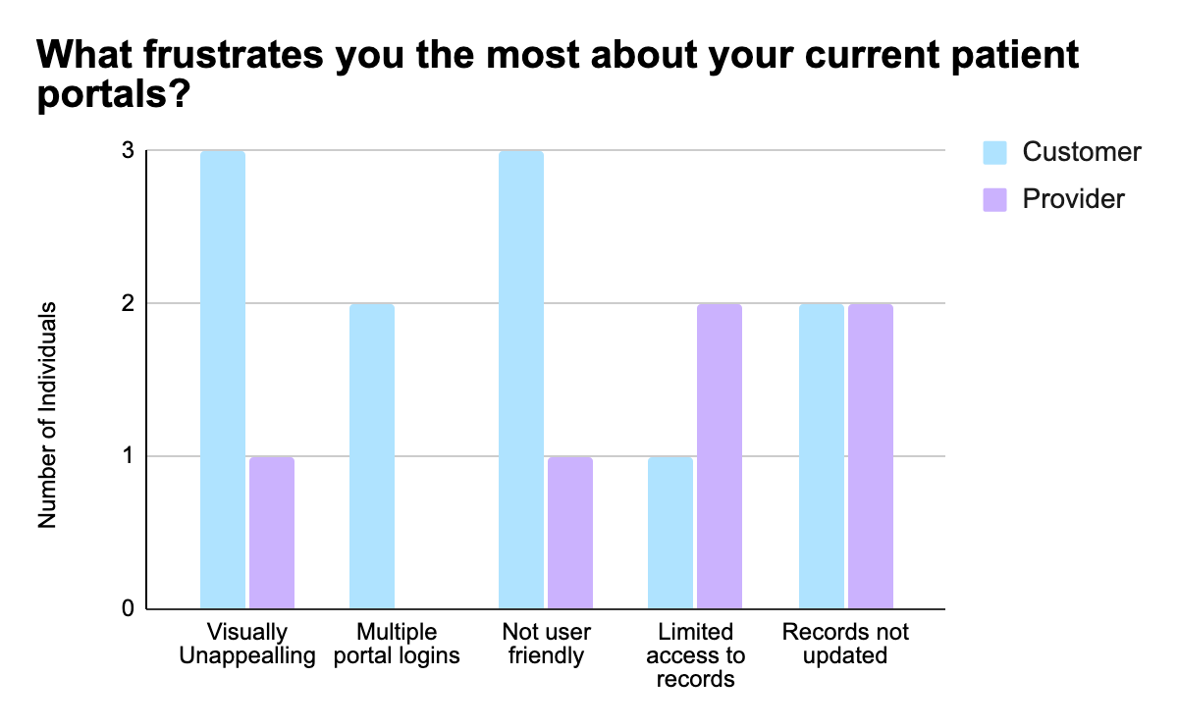
n=8
3 providers
5 customers

